Slide 1
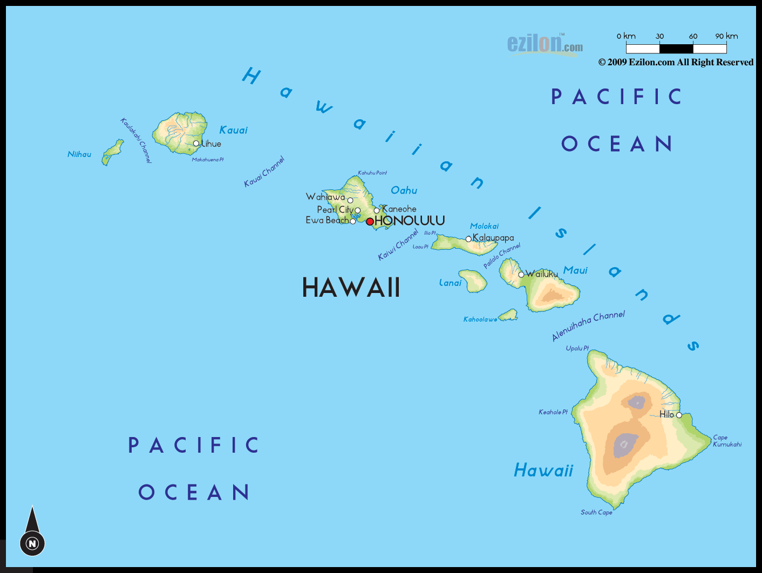

Slide 2
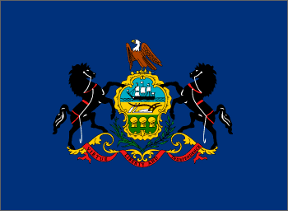
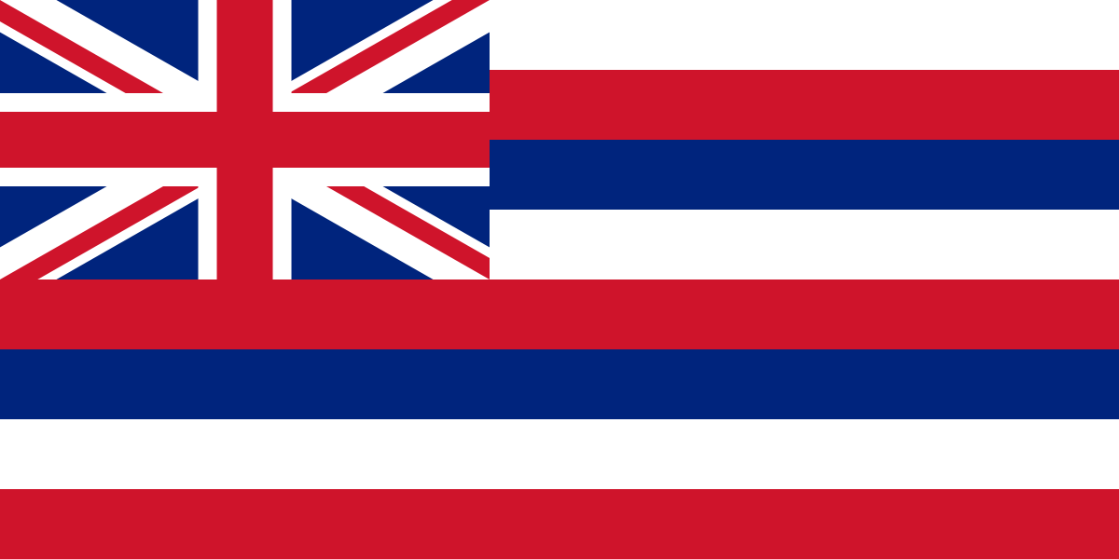
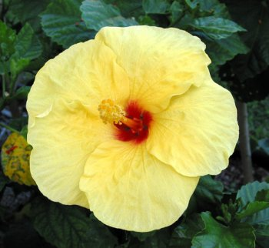
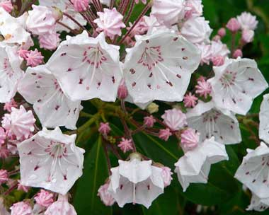
Hawaii
Pennsylvania

Slide 3
Hawai’i pono’i Hawaii’s own true sons
Nana i kou mou’i Be loyal to your chief
Kalani ali’i ke ali’i Your country’s liege and lord, the chief
Ke ali’i The chief
Makua lani e Royal father
Kamehameha e Kamehameha
Na kaua e pale Who defended in war
Me ka ihe With spears

Slide 4
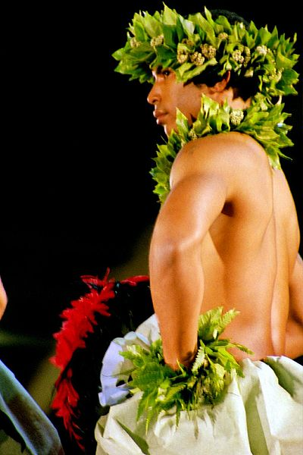
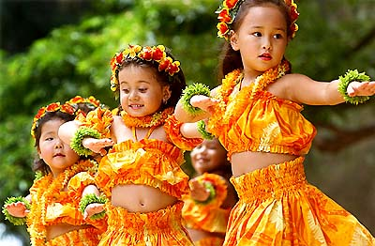
Hula

Slide 5
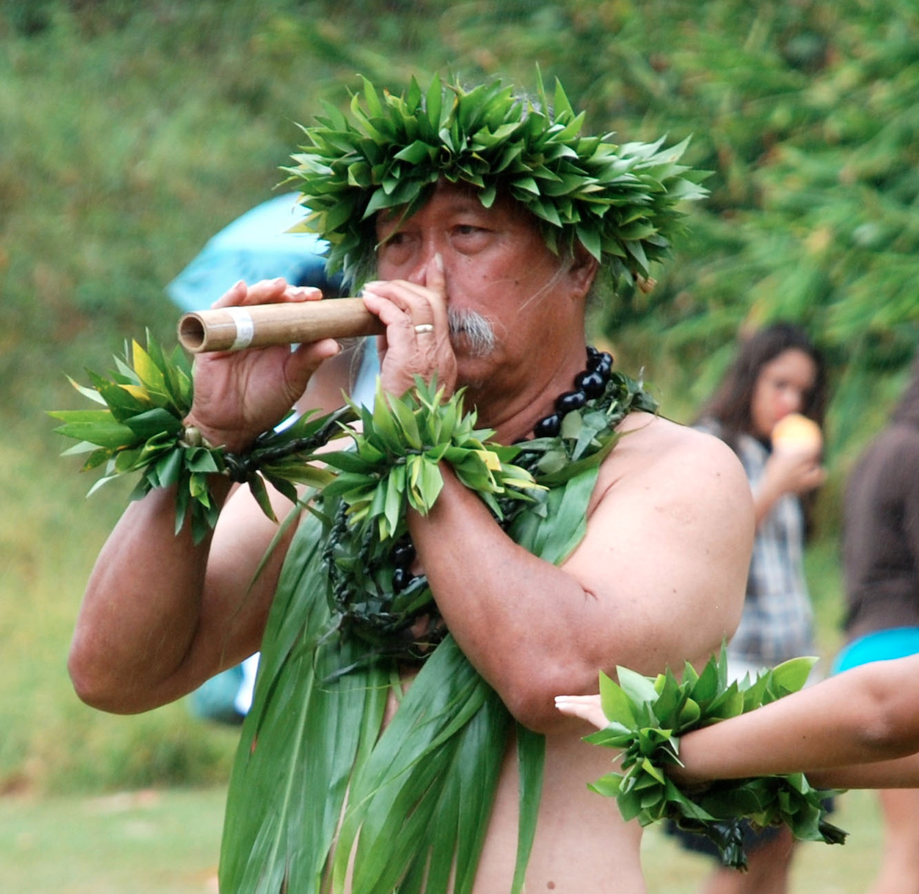
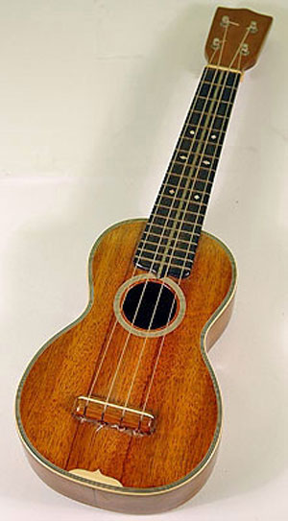
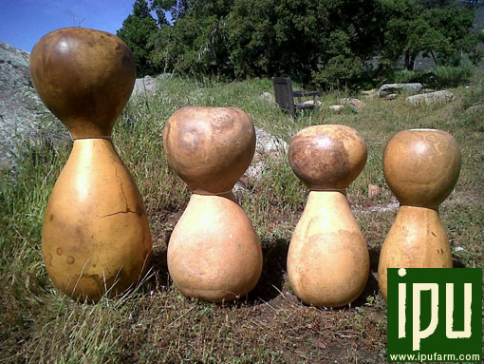
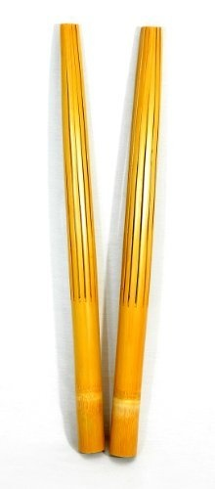
Instruments

